Slide 1
Mastering parameters of advanced functions

Slide 3
Topics Covered
Parameter Attribute
Alias Attribute
Parameter Validation Attributes

Slide 4
Parameter Attribute
Mandatory
Position
ValueFromPipeline
ValueFromPipelineByPropertyName
ValueFromRemainingArguments
HelpMessage
ParameterSetName
Param(
[Parameter(
Mandatory = $true,
HelpMessage = 'Enter a username',
ValueFromPipeline = $true,
ValueFromRemainingArguments = $true
)]
[String]$username
)

Slide 5
Mandatory and HelpMessage
By default, all parameters are optional
Prompts user for missing values on command line
Optional HelpMessage to provide additional information
HelpMessage does not get reflected in Get-Help info
Function Test-Mandatory{
Param (
[Parameter(
Mandatory = $true,
HelpMessage = 'Enter a username'
)]$UserName)
Write-Host $UserName
}
PS> Test-Mandatory
Supply values for the following parameters:
(Type !? for Help.)
UserName: !?
Enter a username
UserName: alpha
alpha
Notes:
Prompts user for missing values on command line even when run from a script
HelpMessage can only be used when mandatory is used
########

Slide 6
Position
By default, all parameters are positional in the order they are defined
Positional Binding can be disabled with the CmdletBinding attribute
Disables positional binding on non-specified parameters
Required to leverage positional binding with parameter sets
Function Test-Position
{
Param (
[Parameter()]$P1,
[Parameter(Position=0)]$P2
)
Write-Host P1 $P1
Write-Host P2 $P2
}
PS> Test-Position 1
P1
P2 1
PS> Test-Position 1 2
Test-Position : A positional parameter cannot be found that accepts argument '2'.
At line:1 char:1
Notes:
Common question
The Position argument still applies if CmdletBinding disabled positional binding
########

Slide 7
ParameterSetName
Specifies the parameter set the parameter belongs to
Parameter sets must have at least one unique parameter
A parameter belongs to all parameter sets if not specified
Function ParamSets {
Param (
[String[]]$IP,
[Parameter(ParameterSetName = "Machine")]
[String[]]$MachineName,
[Parameter(ParameterSetName = "User")]
[String[]]$UserName
)
}
PS> Get-Command ParamSets -Syntax
ParamSets [-IP <string[]>] [-MachineName <string[]>]
ParamSets [-IP <string[]>] [-UserName <string[]>]

Slide 8
ValueFromPipeline
Function Test-ValueFromPipline
{
param([Parameter(ValueFromPipeline)]
[Int]$num)
process
{
Write-Host $num -ForegroundColor Green
}
}
PS> 1,2,"3" | Test-ValueFromPipline
1
2
3
PS> "Fails" | Test-ValueFromPipline
Test-ValueFromPipline : The input object cannot be bound to any parameters for the command
The pipeline object binds to the parameter value
Object on the pipeline is converted to match the parameter type(s)
Any parameter with this attribute can get a copy of the value
Best practice is to only use on one parameter per set
Use process{} block for multiple pipeline objects

Slide 9
ValueFromPipelineByPropertyName
Accepts input from a property of a pipeline object that matches the parameter name
Error thrown if no parameters can be bound
Function Test-PipelineProperty{
param(
[Parameter(ValueFromPipelineByPropertyName)]$Name,
[Parameter(ValueFromPipelineByPropertyName)]$Status,
[Parameter(ValueFromPipelineByPropertyName)]$StartType
)
Process{ Write-Host "$Name is $Status and $StartType" -ForegroundColor Green }
}
PS> Get-service x* | Test-PipelineProperty
XblAuthManager is Stopped and Manual
XblGameSave is Stopped and Manual
XboxGipSvc is Stopped and Manual
XboxNetApiSvc is Stopped and Manual

Slide 10
[Alias()] Attribute
Defines an alias for a function or parameter
Aliases can be recognized by ValueFromPipelineByPropertyName
Aliases do not show in Intellisense
Function Test-Alias{
[Alias("TA")]
Param(
[Parameter()][Alias("CN", "MachineName", "Laptop", "Device")]
[String[]]$ComputerName
)
Write-Host "Computer name: $ComputerName" -ForegroundColor Green
}
PS> TA -CN MyPC
Computer name: MyPC

Slide 11
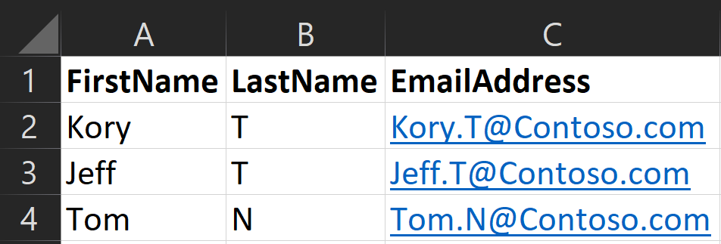
[Alias()] Attribute With Pipeline
Function Test-PipelinePropertyWithAlias
{
param(
[Parameter(ValueFromPipelineByPropertyName)][Alias("FirstName")]$First,
[Parameter(ValueFromPipelineByPropertyName)][Alias("LastName")]$Last,
[Parameter(ValueFromPipelineByPropertyName)][Alias("EmailAddress")]$Email
)
Process
{
Write-Host "$First $Last $Email" -ForegroundColor Green
}
}
PS> Import-Csv .\People.csv | Test-PipelinePropertyWithAlias
Kory T Kory.T@microsoft.com
Jeff T jeff.T@Contoso.com
Tom N Tom.N@Contoso.com

Slide 12
Excess Positional Values
Positional parameters will accept one value per parameter
If extra values are provided, an error occurs
Function Test-RemainingArguments {
Param(
[Parameter(Mandatory = $true)]$GivenName,
[Parameter(Mandatory = $true)]$Surname
)
"GivenName: $GivenName"
"Surname: $Surname"
}
PS> Test-RemainingArguments John Doe Jr
Test-RemainingArguments : A positional parameter cannot be found that accepts argument 'Jr'.

Slide 13
ValueFromRemainingArguments
Allows the parameter to accept overflow parameters
The parameter type is converted to an array of objects
Forces the parameter to be the last position
Only allowed on a single parameter
Function Test-RemainingArguments {
Param(
[Parameter(Mandatory = $true)]$GivenName,
[Parameter(Mandatory = $true, ValueFromRemainingArguments = $true)]$Surname
)
"GivenName: $GivenName"
"Surname: $Surname"
}
PS> Test-RemainingArguments John Doe Jr
GivenName: John
Surname: Doe Jr

Slide 14

Demonstration
Parameter Attributes

Slide 15

Questions?

Slide 16
Parameter Validation Attributes
Provides built-in parameter input validation
Validates values before executing code
Invalid parameter input returns an error
AllowNull()
AllowEmptyString()
AllowEmptyCollection()
ValidateCount()
ValidateLength()
ValidatePattern()
ValidateRange()
ValidateScript()
ValidateSet()
ValidateNotNull()
ValidateNotNullOrEmpty()

Slide 17
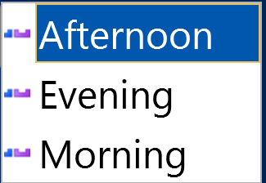
ValidateSet() Attribute
Specifies a set of valid values for a parameter or variable
PowerShell generates an error if a value does not exist in the set
IntelliSense suggests accepted values
Function Write-Hello {
Param (
[ValidateSet("Morning","Afternoon","Evening")]$TimeOfDay
)
"Good $TimeOfDay"
}
PS> Write-Hello -TimeOfDay

Slide 18
Numeric Validation Attributes
Specifies minimum and maximum value
Range applies to numbers
Length applies to string characters
Count applies collection elements
ValidateRange(min, max)
ValidateCount(min, max)
ValidateLength(min, max)
Function Test-Range{
param([ValidateRange(2,5)]$Num)
Write-Host $Num -ForegroundColor Green
}
PS> Test-Range 3
3
PS> Test-Range 6
Test-Range : Cannot validate argument on parameter 'num'. The 6 argument is greater than the maximum allowed range of 5. Supply an argument that is less than or equal to 5 and then try the command again.

Slide 19
Pattern & Script Validation Attributes
Regular Expressions validate value
Script block validates incoming value
Script uses $_ for incoming value
If result is false, an error is thrown
ValidatePattern(“RegEx Pattern”)
ValidateScript({<Script Block>})
Function Test-Pattern {
param([ValidatePattern("\w{2}\d{4}")]$UserName)
Write-Host $UserName -ForegroundColor Green
}
PS> Test-Pattern JD1875
JD1875
PS> Test-Pattern John5
Test-Pattern : Cannot validate argument on parameter 'UserName'. The argument "John5" does not match the "\w{2}\d{4}" pattern. Supply an argument that matches "\w{2}\d{4}" and try the command again.
Regular Expression
2 “word characters”
4 digits

Slide 20
Null validation attributes
AllowNull()
AllowEmptyString()
AllowEmptyCollection()
ValidateNotNull()
ValidateNotNullOrEmpty()
Allow
Allows mandatory parameters to be null or empty.
ValidateNot
Designed to force un-typed optional parameters to have a value if used.

Slide 21
Demonstration
Parameter Validation

Slide 22
Questions?

Slide 23

Mastering Parameters
60 minutes

